Slide 1
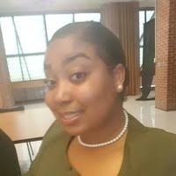
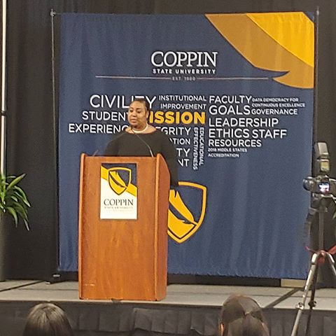
Who is Arynne Wilburn?
February 2nd, 2019
DANC 102 SEC002 Spring 2019

Slide 2

Major
I am a pre-nursing Major!

Slide 3

University Status
I am a Junior
Third Year

Slide 4

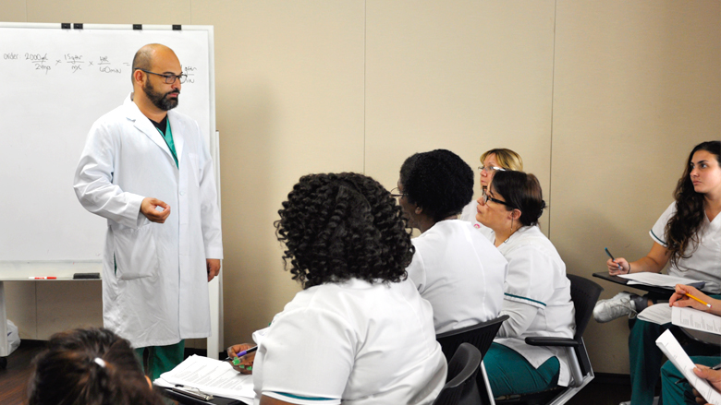
Goals
My goal is to receive my doctorate in nursing practice
With my Doctorate I would run a nursing unit in a pediatric hospital
I would also become a part-time professor at a university teaching Anatomy and Physiology, Algebra, Chemistry, Biology, and etc.

Slide 5
Purpose
Everyone Has a Purpose
In my life several miracles have occurred that allowed me to realize that I have a purpose of helping others
I realized during my college career that my purpose is to work in administration and help behind the scene to make sure that all work is being done successfully

Slide 6

Aspirations
I hope to live a prosperous life where I am successful in my entire life span and take care of my family.

Slide 7

Why take Yoga?
I decided to take yoga because of 2 reasons:
I need to fill up courses in order to have at least 12 credits to stay on campus
I have a tendency of overly stressing over a lot of instances that I am unable to control
I am hopeful that Yoga will influence peace and serenity in my life and help me not stress!

